Slide 1
Getting Started with SharePoint 2010
Notes:
This introductory module introduces students to the fundamental terminology and architecture of SharePoint Foundation and describes the new platform enhancements with the greatest impact on SharePoint administrators. The module also examines the different editions available for SharePoint Server 2010. The module concludes with a discussion of hardware and software requirements and using virtualization techniques to build testing and production environments.

Slide 2
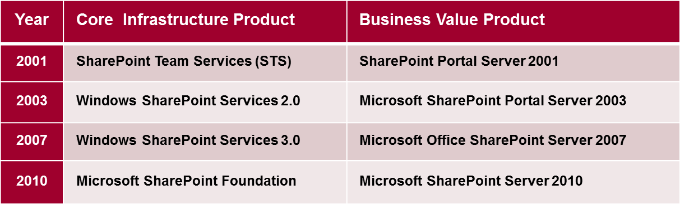
A Brief History of SharePoint
Milestone Releases of SharePoint Technologies
Notes:
SharePoint 2001 introduced the idea of an environment that allows users to create sites, lists and document libraries on demand based on a data driven design. The implementation was based on a SQL Server database that tracked the creation of sites and lists by adding records to a static set of database tables. This initial version of SharePoint had several noteworthy shortcomings. First, it was very cumbersome to customize sites. Second, the files uploaded to a document library were stored on the local file system of the front end Web Server which made it impossible to scale out SharePoint Team Services sites using a farm of front end Web servers.
SharePoint 2003 was the first version to be implemented on top of the .NET Framework and ASP.NET. This is also the version where Microsoft altered the implementation for document libraries to store its files inside a backend SQL Server database which made it possible to scale out SharePoint sites using a standard farm of front end Web Servers.
SharePoint 2007 introduced many new concepts to the underlying SharePoint architecture including Site Columns, Content Types, Features and Solution Packages. Microsoft also improved SharePoint's integration with ASP.NET.
SharePoint 2010 is the fourth and most-recent release of SharePoint technologies and it includes SharePoint Foundation and SharePoint Server 2010. The goal of this lecture is to build your high-level understanding of the SharePoint Foundation from the viewpoint of a IT professional. This lecture will also explain how SharePoint Server 2010 extends SharePoint Foundation to add extra functionality and business value.

Slide 3
Student Questionnaire
Questions about you
What is your name?
What company are you with?
Questions about your background
What is your experience with Windows Server?
What is your experience with Active Directory?
What is your experience with SQL Server?
What is your experience with SharePoint?

Slide 4
Agenda
SharePoint Foundation Architecture
What's New in SharePoint 2010
SharePoint 2010 Product SKUs
Virtualization using Hyper-V

Slide 5
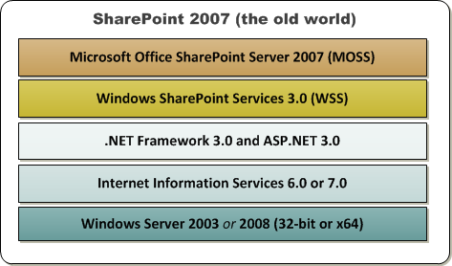
Reflecting on SharePoint 2007
Windows SharePoint Services (WSS 3.0)
basic infrastructure for creating and managing sites
Microsoft Office SharePoint Server (MOSS)
value-added software built on WSS 3.0
Notes:
Many student will be familiar with WSS 3.0 and MOSS. Here are some questions that each student should answer.
Are you familiar with MOSS 2007 and WSS 3.0
as a user?
as a site administrator?
as a farm administrator?
as a developer?

Slide 6
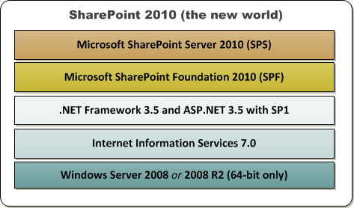
Moving to SharePoint 2010
Microsoft SharePoint Foundation 2010
basic infrastructure for creating and managing sites
Microsoft SharePoint Server 2010
value-added software built on SharePoint Foundation
Notes:
SharePoint Foundation and SharePoint Server 2010 are only available in 64-bit versions. They can be installed on a 64-bit version of Windows Server 2008 or Windows Server 2008 R2. When building a development or testing environment, you also have the option of installing either SharePoint Foundation or SharePoint Server 2010 on a 64-bit version of a client operating system such as a Windows 7 or Windows Vista.
SharePoint Foundation leverages Internet Information Services 7.0 (IIS) on front-end Web servers to listen for incoming HTTP requests and to manage the server-side worker processes using the IIS Application Pool infrastructure. The runtime environment of SharePoint Foundation runs within a worker process launched from the IIS Application Pool executable named W3WP.EXE.
You should also take note that the initial release of SharePoint 2010 will not provide support for .NET 4.0. At the time of this writing, Microsoft has not yet made any announcements as to when they will integrate .NET 4.0 support into either SharePoint Foundation or SharePoint Server 2010.

Slide 7
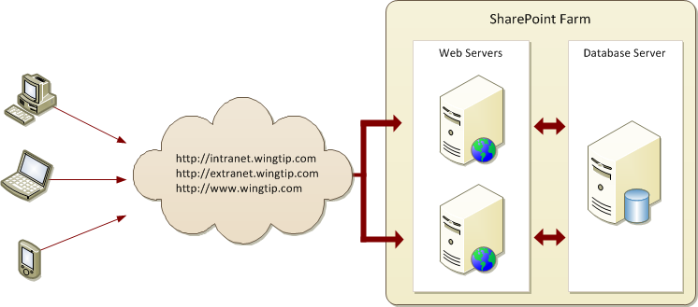
SharePoint Farms
SharePoint deployment based on farms
Farm runs Web server(s) and database server
Farm can be single server or multi-server
Each farm has exactly one configuration database
Notes:
A SharePoint farm can be single server or multi-server. Each SharePoint farm has only one configuration database.
At its core, SharePoint Foundation is a provisioning engine; it's fundamental design is based on the idea of using Web-based templates to create sites, lists and libraries to store and organize content. There are templates used to create new Web sites. There are also templates used to create various elements inside a Web site such as lists, pages and Web Parts.
SharePoint Foundation is particularly helpful to companies and organizations that are faced with the task of creating and administering a large number of Web sites because it dramatically reduces the amount of work required. The act of provisioning (a fancy word for creating) a site in SharePoint Foundation can be accomplished by someone in the IT department or by an ordinary business user in less than a minute by filling in a browser-based form and clicking the OK button. Creating a new page or a new list inside a site is just as easy.
SharePoint Foundation takes care of all the provisioning details behind the scenes by adding and modifying records in a SQL Server database. There’s no need for a database administrator to create a new database or any new tables. There’s no need for an ASP.NET developer to create a new ASP.NET Web site to supply a user interface. There’s no need for a system administrator to copy any ASP.NET source files to the front-end Web server. It all just works. That's the magic of SharePoint.

Slide 8
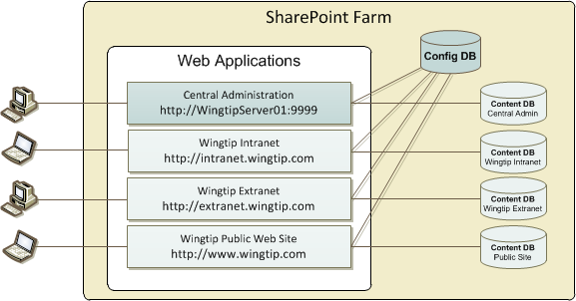
Web Applications
Web Applications provide HTTP entry points
Web applications configured on top of IIS Web sites
Web application provides scope for creating sites
Web application used to configure authentication
Notes:
SharePoint Foundation is built on top of Internet Information Services 7.0 (IIS). SharePoint Foundation relies on IIS Web sites to handle incoming HTTP requests. Therefore, it's important you understand exactly what an IIS Web site really is.
An IIS Web site provides an entry point into the IIS Web server infrastructure. For example, the Default Web Site created automatically by IIS listens for incoming HTTP requests on port 80. You can create additional IIS Web sites to provide additional HTTP entry points using different port numbers, different IP addresses, or different host headers. In our scenario, we'll use host headers to create HTTP entry points for domain names such as http://intranet.wingtip.com.
SharePoint Foundation creates an abstraction on top of IIS known as a Web Application. At a physical level, a Web Application is a collection of one or more IIS Web sites configured to map incoming HTTP requests to a set of SharePoint sites. The Web application also maps each SharePoint site to one or more specific content databases. SharePoint Foundation uses content databases to store site content such as list items, documents and customization information.

Slide 9
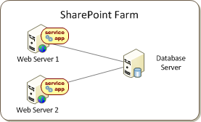
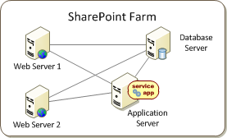
Service Applications
Services application facilitate resource sharing
New architecture introduced in SharePoint 2010
Replaces Shared Service Providers (SSPs)
Service applications can run on Web Server(s)
Service application can be run on dedicated application server(s)
Notes:
Scaling a SharePoint farm is often achieved by efficiently sharing resources across sites running in different Web applications and by offloading processing cycles from front-end Web servers to dedicated application servers. SharePoint 2007 provides a resource-sharing architecture based on Shared Service Providers (SSPs). However, SSPs are not ideal because they have no support in the core platform. They are part of the SharePoint Server 2007 product and they do not support extensibility.
SharePoint Foundation introduces a new infrastructure for service applications which replaces the older SSP architecture from SharePoint Server 2007. In SharePoint 2010, service applications are used to facilitate sharing resources across sites running in different Web applications and different farms. The new service application architecture also provides the means for scaling a SharePoint farm by offloading processing cycles from the front end Web servers over to dedicated application servers.
A key benefit to this new architecture is that you can treat a service application as a pluggable component. Once a service application has been installed and created, it can be configured for several different deployment scenarios. In simple farms, an instance of the service application can run on each front-end Web server. In more complex farms such as the one shown at the bottom of the slide, a service application can be configured to run on a separate application server or in a farm of application servers.

Slide 10
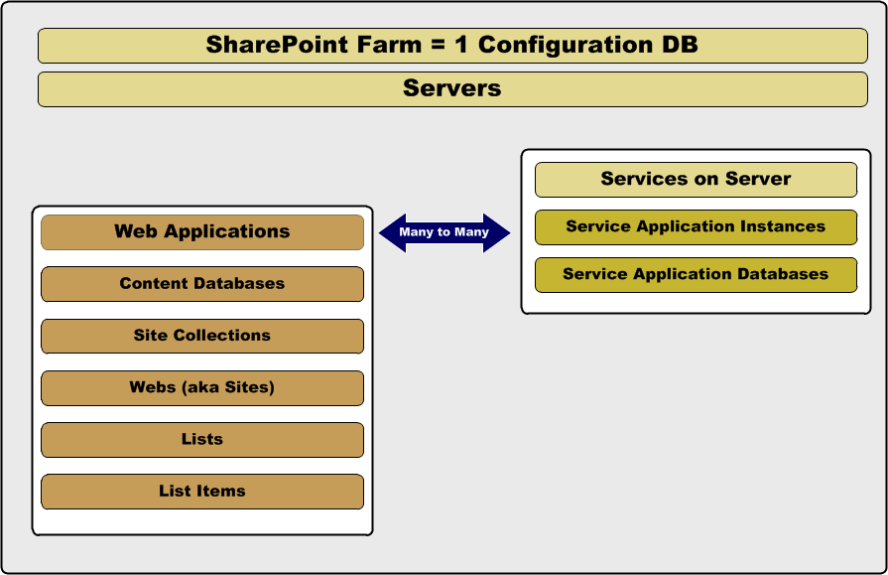
SharePoint Containment Hierarchy
Notes:
Each SharePoint farm represents the top of a hierarchy which contains one or more servers. One or more of these servers play the role of the Web Front End (WFE) which provides the HTTP entry points for SharePoint sites using Web applications. Each Web application has at least one content database but can have several more. Each content database can have many site collections. Each site collection has a top-level webs (aka sites) and can also have child webs as well. Each Web can have many lists. Each list can have many items.
Each server in the farm can be configured to run one or more services. These services together with the Central Administration application can be used to create, configure and run service application instances. You will typically create many service application instances in each farm during the initial farm configuration. For most types of services, the creation (i.e. provisioning) of a service application instance involves creating one or more service application databases.
You should understand that you can also create two or more service application instances within the same farm based on the same service. For example, one farm could have two service application instances based on the Search service and two more service application instances based on the User Profile service. This would allow you to configure one Web application (and all the sites inside) to use one specific instance of the Search serviceand the User Profile service. You could then configure a second Web application (and all the sites inside) to use the other instance of the Search service and the User Profile service effectively isolating the database storage of one group of users from another.

Slide 11
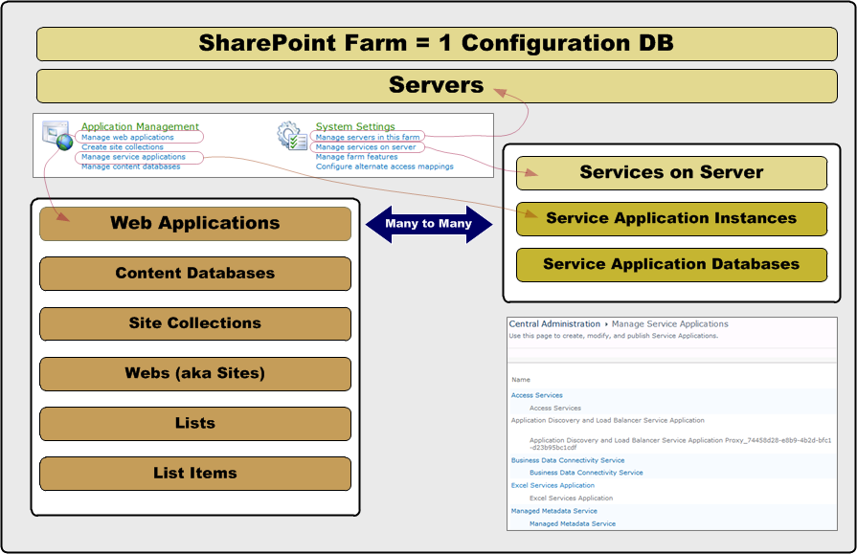
Configuring a SharePoint Farm in CA
Notes:
System Settings
Manage servers in this farm links to an administration page that makes it possible to view, add and remove servers from the current farm.
Manages services on server links to an administration page that makes it possible to stop and start services running on specific servers within the farm.
Application Management
Manage web applicationslinks to an administration page that makes it possible to view, create, configure and remove Web applications inside the current farm.
Manage service applicationslinks to an administration page that makes it possible to view, create, configure and remove service application instances inside the current farm.

Slide 12
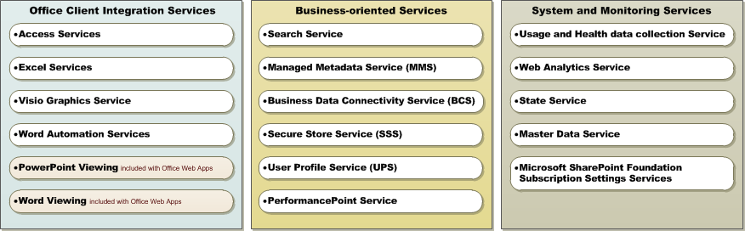
SharePoint 2010 Service Applications
SharePoint 2010 includes services applications
Some focus on Office client integration services
Some provide business-oriented services
Some provide system and monitoring services
KEY POINT: you should learn about what each service provides so you can decide which service application instances to create and configure
Notes:
Application Registry Service: Backwards compatible Business Data Connectivity API.
Business Data Connectivity Service: Enabling this service provides the SharePoint farm with the ability to upload BCS models that describe the interfaces of your enterprises' line of business systems and thereby access the data within these systems. Lotus Notes Connector: Search connector to crawl the data in the Lotus Notes server.
Managed Metadata Service: This service provides access to managed taxonomy hierarchies, keywords and social tagging infrastructure as well as Content Type publishing across site collections.
Search Service Application: Index content and serve search queries.
Secure Store Service: Provides capability to store data (e.g. credential set) securely and associate it to a specific identity or group of identities.
State Service: Provides temporary storage of user session data for SharePoint Server components.
Usage and Health data collection: This service collects farm wide usage and health data and provides the ability to view various usage and health reports.
User Profile Service Application: Adds support for My Sites, Profiles pages, Social Tagging and other social computing features. Some of the features offered by this service require Search Service Application and Managed Metadata Services to be provisioned. Learn about security implications related to this option.
Web Analytics Service Application: Web Analytics Service Application
Word Automation Services: Provides a framework for performing automated document conversions.

Slide 13
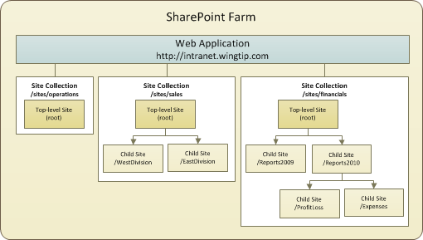
Site Collections and Sites
Sites are partitioned into Site Collections
Site collection is scope for administrative privileges
Site collection always contains top-level site
Site collection may contain hierarchy of child sites
Web application can support 1000s of site collections
Notes:
Every SharePoint Web must be provisioned within the scope of an existing Web application. However, a Web cannot exist as an independent entity within a Web application. Instead, every Web must also be created inside the scope of a site collection.
A site collection is a container of Webs. Every site collection has a top-level Web. In addition to the top-level Web, a site collection can optionally contain a hierarchy of child Webs below. The diagram in the slide shows a Web application with three site collections. The first site collection contains just a top-level site. The second site collection contains one level of child sites below the top-level site. The third site collection contains a more complex hierarchy with three levels.
Let’s walk through an example. The Wingtip IT staff is responsible for provisioning new site collections when one of the Wingtip business divisions submits a request for a new site. Imagine the case where the Wingtip Sales Director has put in a request to create a new team site for his sales staff. A Wingtip IT staff member would handle this request by creating a new site collection with a team site as its top-level site.
When creating the new site collection, the Wingtip IT staff member would add the Wingtip Sales Director who requested the site as the site collection owner. This gives the Wingtip Sales Director full administrative privileges inside the site collection and makes it possible for him to add new users, lists and pages without any further assistance from the Wingtip IT staff. The Wingtip Sales Director can also add child sites and configure access rights to them independently of the top-level site.

Slide 14
Agenda
SharePoint Foundation Architecture
What's New in SharePoint 2010
SharePoint 2010 Product SKUs
Virtualization using Hyper-V

Slide 15
What's New for SharePoint Users?
New User Interface
Better Office Client Integration
Much improved version of SharePoint Designer
SharePoint Workspace (Groove reincarnated)
Office Web Applications

Slide 16
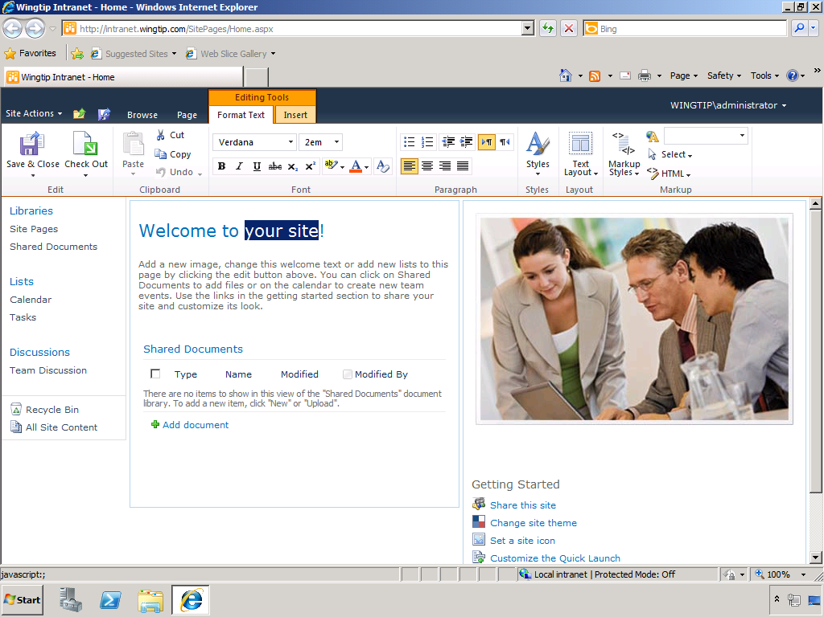
The SharePoint 2010 User Experience
User Interface Redesigned for SharePoint 2010
Redesigned for Web 2.0 look and feel
Abandons dated HTML layout from SharePoint 2007
Relies on HTML that works better across browsers
Introduces new tab-oriented server-side ribbon
Notes:
SharePoint Foundation introduces many changes to the core platform from SharePoint 2007 although the improved user experience in the browser will constitute the most obvious change for experienced SharePoint users moving to SharePoint 2010.
In a nutshell, the SharePoint 2007 user interface experience is outdated. It was not designed to today's HTML standards nor does it embrace any of the principles of Web 2.0. This negatively impacts accessibility and cross-browser functionality. The user experience of SharePoint 2007 can also be criticized for triggering unnecessary server-side post backs and confusing page transitions.
SharePoint 2010 introduces a new user interface that significantly improves the user experience using the concepts of Web 2.0. The pages in a SharePoint 2010 site eliminate unnecessary post backs by communicating with the Web server using asynchronous JavaScript calls. SharePoint Foundation also eliminates potentially confusing page transitions using inline editing and modal dialogs. Finally, SharePoint Foundation enhances the user experience by introducing the server-side Ribbonwhich allows the user to locate and execute a larger number of contextual commands without having to navigate away from the current page

Slide 17
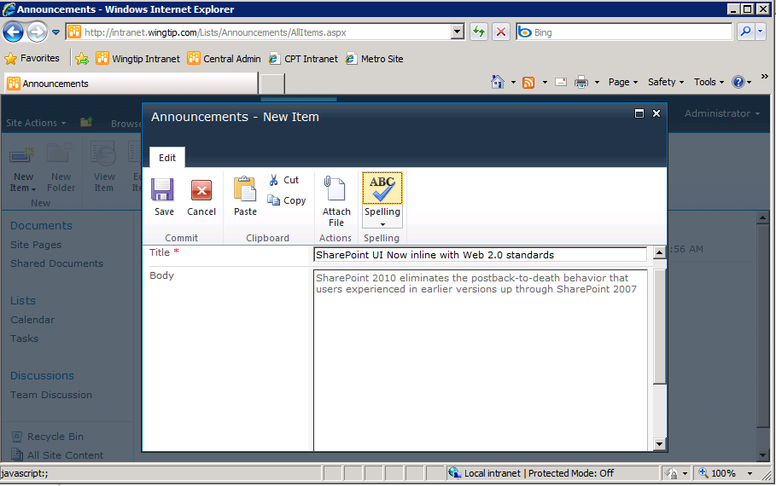
A Much Improved User Experience (UX)
SharePoint 2010 UI designed for Web 2.0 standards
in-place Editing
modal dialogs
far fewer postbacks
Notes:
There has been a major overhaul to the most basic aspects of the SharePoint UI. Many of these changes have been designed to get rid of all the HTTP postbacks that are required when making updates in the browser. SharePoint 2010 has a new core engine for processing pages based on ASP.NET AJAX and designed to delivery a more of a Web 2.0 user experience.
SharePoint 2010 adds a new server-side ribbon to create a consistency with the client-side ribbon added to Office applications with the release of the Office 2007 system. The ribbon now provides a JavaScript-enabled paradigm where the user can move between modes (e.g. edit mode versus display mode) without sending postbacks to the Web server. In-place editing is the most obvious change that users will notice when moving from SharePoint 2007.

Slide 18
DEMO
Creating and Customizing a new
SharePoint 2010 Team Site

Slide 19
What's New for the IT Pro?
Managed Accounts
Claims-based Security
Resource and List Throttling
List content accessed via REST-based services
Windows PowerShell Scripting Support
Multi-tenancy Hosting and Site Subscriptions
Remote BLOB Storage (RBS)
Control over SharePoint Designer permissions
Notes:
Managed Accounts: A feature which lets SharePoint 2010 take over control of managing passwords for the account that are used as service accounts.
Claims-based Security: A new security model which opens of SharePoint 2010 to the possibility of authenticating users using external identity providers such as Windows Lie ID.
Resource and List Throttling: New control for the farm administrator to prevent users from running large queries that might compromise the reliability and responsiveness of the farm.
List content accessed via REST-based services: SharePoint 2010 provides an entry point for external application that want to read and write items in a SharePoint list. This functionality is provided by WCF Data Services and a SharePoint Foundation file named ListData.svc.
Windows PowerShell Scripting Support: SharePoint 2010 introduces first class support for automating administrative tasks using Windows PowerShell scripting, Any farm administrator moving to SharePoint 2010 that does not know PowerShell needs to learn it.
Multi-tenancy Hosting and Site Subscriptions: The Multi-tenancy Hosting features make it possible to host site collection from different companies and organization on the same farm and even within the same Web application. The main things these features do is isolate a group of site collections so they do not share any database with other companies.
Remote BLOB Storage (RBS): This feature makes it possible to store large file in a document library but the file content is not written to the content database. The RBS features make it possible to store the file itself in other media more appropriate.
Control over SharePoint Designer permissions: Finally!

Slide 20
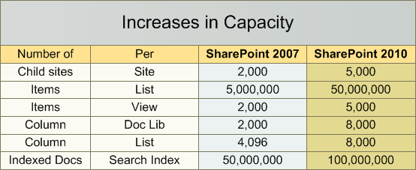
Capacity Increases with SharePoint 2010
SharePoint 2010 Increase Capacity
Notes:
Here are a few topically-related whitepapers from Microsoft
SharePoint Server 2010 capacity management: software boundaries and limits: http://www.microsoft.com/downloads/details.aspx?displaylang=en&FamilyID=66438e41-5733-448a-bd76-a8052b394fe2
Capacity management and sizing for SharePoint Server 2010 http://www.microsoft.com/downloads/details.aspx?familyid=B9091243-0E17-404D-8853-57309F885722&displaylang=en
SharePoint Server 2010 performance and capacity test results and recommendations http://www.microsoft.com/downloads/details.aspx?familyid=FD1EAC86-AD47-4865-9378-80040D08AC55&displaylang=en

Slide 21
Agenda
SharePoint Foundation Architecture
What's New in SharePoint 2010
SharePoint 2010 Product SKUs
Virtualization using Hyper-V

Slide 22
SharePoint 2010 Product SKUs
SharePoint Foundation (free download)
SharePoint Server 2010
Standard Edition (requires CALs)
Enterprise Edition (requires CALs)
SharePoint Server 2010 for Internet Sites (FIS)
Standard Edition (does not require CALs for external users)
Enterprise Edition (does not require CALs for external users)
Notes:
SharePoint Foundation provides the core infrastructure and it can be used without any SharePoint-specific licensing. People often refer to this as a free product. However, Microsoft prefers to refer to it as a "free download" instead of a "free product".
Using SharePoint Server 2010 requires service licenses as well as client access licenses (CALs). There is also two primary editions which are Standard Edition and Enterprise Edition. Therefore companies need to purchases a server license for each server onto which you will install SharePoint. You will also need to purchase a Standard CAL for each user that accesses the farm. If you plan to use Enterprise Edition features, you must then purchase an Enterprise CAL in addition to the standard CAL..
In SharePoint 2007, the entry price of standing up a public-facing Web site on the Internet using the SharePoint publishing was more than most small to medium sized companies were willing to pay. SharePoint 2010 introduces a new licensing scheme for Internet sites with a lower price point that is designed to get more market penetration into small and medium sized companies. The SKU is named SharePoint Server 2010 for Internet Sites (FIS) and it's main distinction is that is does not require CALs.
The SharePoint Server FIS SKU has both a Standard Edition and Enterprise Edition. However, you should not assume that Standard FIS has the same features as the regular edition of SharePoint Server 2010 with a Standard CAL. There is less functionality in the FIS editions and consequently, that is why the price is lower.

Slide 23
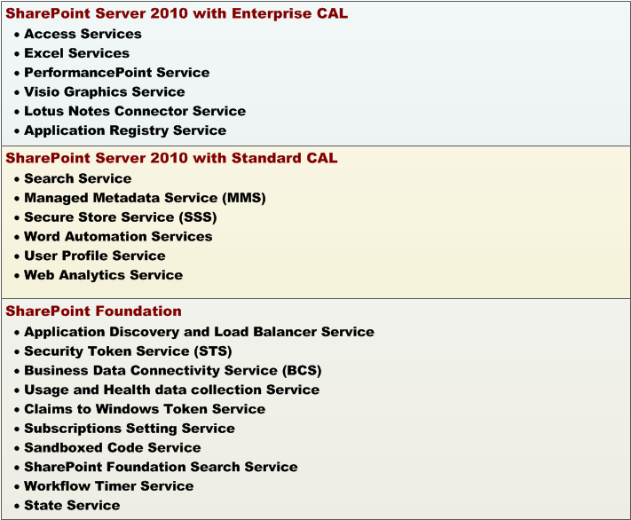
Service Applications by SKU
Notes:
Here is a list of the primary services application you will be creating and configuring
Access Services: Allows user to upload Access database and converts it into a SharePoint site.
Excel Services Application: Allows server-side loading and calculating of Excel workbooks as well as facilities for users to view and interact with Excel workbooks in the browser.
PerformancePoint Service Application: Allows users to use a graphical dashboard designer to create business intelligence objects such as KPIs, scorecards and charts from a data warehouse such as SQL Server Analysis Services.
Visio Graphics Service: Enables server-side rending of Visio Web Drawings.
Lotus Notes Connector: Search connector to crawl the data in the Lotus Notes server.
Application Registry Service: Backwards compatibility support for Business Data Connectivity in SharePoint 2007.
Search Service Application: Management UI and infrastructure to crawl content, build Indexes and execute search queries on behalf of users.
Managed Metadata Service: This service provides access to managed taxonomy hierarchies, keywords and social tagging infrastructure as well as Content Type publishing across site collections.
Secure Store Service: Provides capability to store credentials and associate them with a specific identity or group of identities.
User Profile Service Application: Adds support for My Sites, Profiles pages, Social Tagging and other social computing features. Some of the features offered by this service require Search Service Application and Managed Metadata Services to be provisioned.
Web Analytics Service Application: Provides analytic data and reporting for sites in a SharePoint farm.
Word Automation Services: Provides support for automating document conversions to formats such as PDF and XPS.
Business Data Connectivity Service (BCS): Provides support for exposing external content from databases and Web services as a list in a SharePoint site. BCS also provide client-side support used by Office client applications.
State Service: Provides temporary storage of user session data for SharePoint Server components and is required by various other services such as InfoPath Forms Services.
Usage and Health data collection: This service collects farm wide usage and health data and provides the ability to view various usage and health reports.

Slide 24
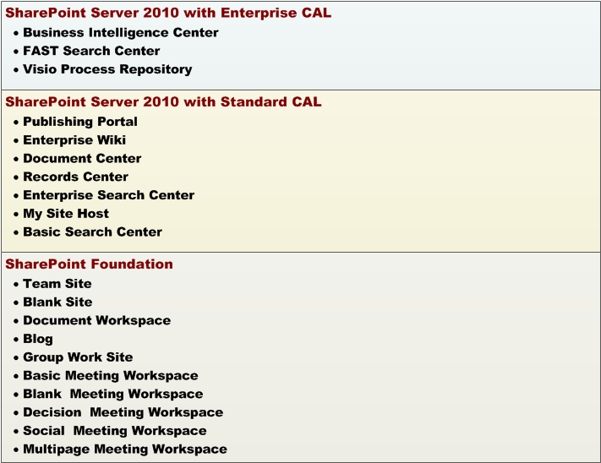
Site Templates by SKU
Notes:
SharePoint Foundation
Team site template: creates site with pre-created collaboration lists allowing small t medium sized teams to upload, author, organize and share information.
Blank site template: creates vanilla site without pre-created collaboration lists.
SharePoint Server 2010 Standard
Publishing Portal: create site based on SharePoint Server's infrastructure for publishing content in an Internet-facing site. Includes workflows for content approval.
Enterprise Wiki: Creates a publishing site in which the publishing pages are wiki pages.
Document Center: creates site to manage and organize a large number of documents.
Records Center: creates site to upload, manage and organize a large number of records.
Enterprise Search Center:. creates sites with a UI specialized for searching and seeing search results.
My Site Host:. creates generic host site which is used to display different user profiles.
SharePoint Server 2010 Enterprise
Business Intelligence Center: creates site with integration points for SharePoint Server 2010 Enterprise BI features PerformancePoint Services, Excel Services, SQL Server Reporting Services (SSRS) and SQL Server Analysis Services (SSAS) .

Slide 25
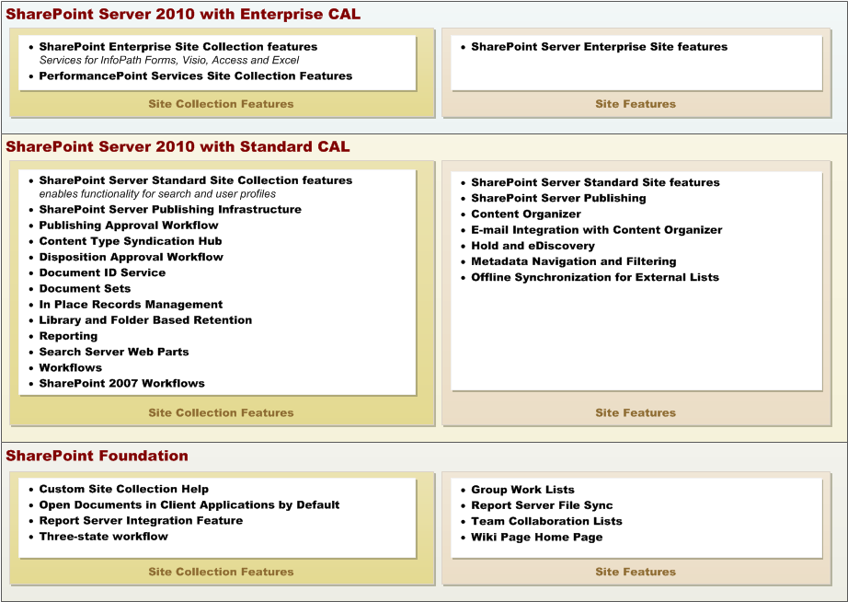
Features By SKU
Notes:
SharePoint Foundation Features
Custom Site Collection Help: Creates a Help library to store custom help info.
Open Documents in Client Applications by Default: Configures links to documents so they open in client applications instead of Web applications, by default.
Report Server Integration Feature: Enables rich reporting using Microsoft SQL Server Reporting Services.
Three-state workflow: Use this workflow to track items in a list.
Group Work Lists: Provides Calendars with added functionality for team and resource scheduling.
Report Server File Sync: Synchronizes Report Server files (.rdl, .rsds, .smdl, .rsd, .rsc) from a SharePoint document library to the report server when files are added or updated in the document library.
Team Collaboration Lists: Provides team collaboration capabilities for a site by making standard lists, such as document libraries and issues, available.
Wiki Page Home Page: This site feature will create a wiki page and set it as your site home page.

Slide 26
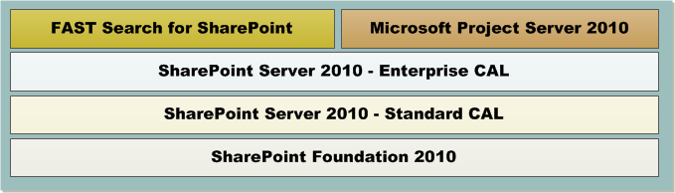
Adding On Top of Enterprise CALs
Some Products require Enterprise CALs
FAST Search for SharePoint
Microsoft Project Server
Notes:
FAST Search for SharePoint
FAST Search Server 2010 for SharePoint builds on SharePoint Server 2010, and provides significant enhancements to the Enterprise Search capabilities. It adds capabilities to deliver results that are contextually relevant. Relevancy can be tuned to improve accuracy. It provides users with results that are meaningful and dynamically tailored to their jobs, roles, and functions within the organization.
Microsoft Project Server 2010
Project Server 2010 allows for professional project management andhelps organizations align resources and investments with business priorities, gain control across all kinds of work, and visualize performance using powerful dashboards. Along with the Excel Services feature provided by SharePoint Server 2010, now offer the ability to publish Excel-based reports to the web for business users to consume without the need to download and launch them in Excel.

Slide 27
FAST Search
FAST Search Server 2010
For SharePoint
For SharePoint Internet sites
For Internet Business
FAST Search for SharePoint:
High-end search
FAST Search for Internet Business: Search capabilities tuned to drive more revenue through Web sites.
Ex. BestBuy.com is using FAST search
Notes:
FAST Search Server 2010 for SharePoint
FAST Search Server 2010 for SharePoint provides high-end search delivered through SharePoint.This is the server infrastructure that provides processing, indexing and query capabilities, and the administration of these features.
FAST Search Server 2010 can be used in combination with SharePoint, SharePoint Internet Sites and SharePoint for Internet Business.

Slide 28
SharePoint Search versus FAST Search
SharePoint Server 2010
Complete Intranet Search Solution
Enterprise-class intranet search Scalable, searches LOB systems, improved people search
FAST Search Server for SharePoint 2010
Powerful high-end search with refinement
Delivered through SharePoint
Good option for building custom search solutions and integrated applications
Notes:
SharePoint Server 2010 offers a complete intranet search sollution with following features and capabilities:
People Search
Search on Taxonomy
Metadata – driven refinement panel
Phonetic search
FAST Search Server 2010 for Sharepoint adds the following features and capabilities:
Contextual Search
Thumbnails and previews
Business intelligence indexing connector
Capabilities for building custom integrated search applications

Slide 29
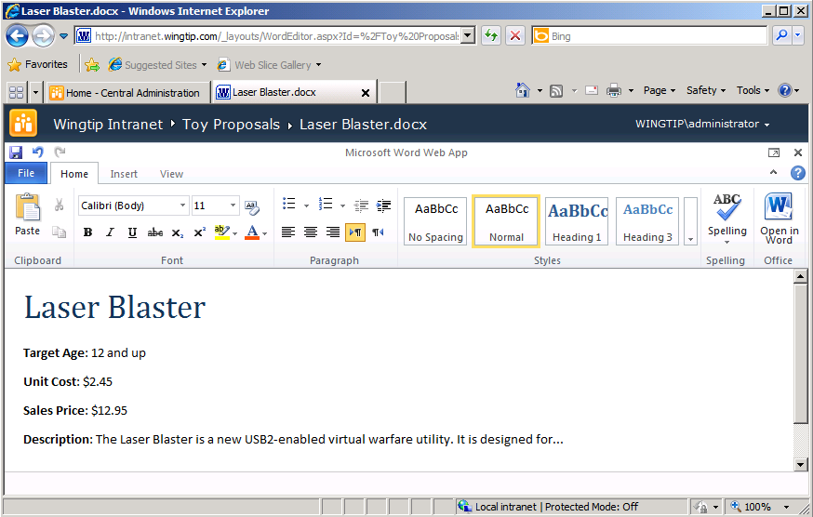
Office Web Apps
Adds browser ability to view and edit Office documents
Word Viewer Service
Excel Services
PowerPoint Viewer Service
Licensed as Microsoft Office product not a SharePoint product
Notes:
Office Web Applications is tightly integrated with SharePoint 2010 Products and gives users a browser-based viewing and editing experience by providing a representation of an Office document in the browser. When a user clicks on a document stored in a SharePoint document library, the document opens directly in the browser. The document appears in the browser similar to how it appears in the Office client application. The Web app also provides many of the same editing features as an Office client application.

Slide 30
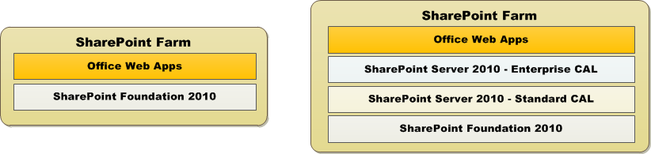
Deploying Office Web Apps
Can be installed on any SharePoint 2010 farm
Installs on SharePoint Foundation farms
Installs on SharePoint Server 2010 farms
Installation adds Office Web Apps service applications
Functionality enabled by activating site collection feature
Notes:
When you install Office Web Apps on a server, the Word Viewing Service, PowerPoint Service, and Excel Calculation Services are created in SharePoint Services. Each of these services acts as a service instance for each Office Web App on a stand-alone server or a service instance for each Office Web App on each server in a server farm. Only one service instance for each Office Web App can exist on a single server, but multiple service instances can exist for each Office Web App in a server farm. Each service instance provides a location where a service application is run.

Slide 31
SharePoint Online
SharePoint in the cloud
Intranet User Subscription License (USL)
Enterprise
Standard
SharePoint Online Deskless Worker
Extranet/Internet
Internet Sites
Partner Sites
Notes:
SharePoint 2010 Online includes all the Business Intelligence aspects, like Excel Services, Forms Server, Dashboards, Key Performance indicators.
SharePoint Online Deskless Worker gives users read-only access to portals, along with the capability to participate in discussions and surveys

Slide 32
Agenda
SharePoint Foundation Architecture
What's New in SharePoint 2010
SharePoint 2010 Product SKUs
Virtualization using Hyper-V

Slide 33
What about Virtualization
Reduce Hardware
Increase Savings
Hosted or Bare Metal Hypervisor
Multiple Physical Hosts can support numerous environments (High Availability)
Virtualized SharePoint is fully supported
Hyper V, VMWare ESX, Citrix ZenServer etc.
Notes:
Reducing the overall footprint of hardware in a datacenter will provide a savings in cost (hardware) but will also decrease power usage and emissions.
“Bare Metal” hypervisors are software systems, such as Windows Server 2008 with Hyper-V and VMWARE ESX Server, that execute directly on the host’s hardware as a hardware control and guest operating system monitor. The guest operating system which hosts SharePoint software executes directly above the hypervisor.
“Hosted” hypervisors are software applications running within a conventional operating system environment, typically as a service. Examples include Microsoft Virtual Server 2005 R2 and VMWare Server. The guest operating system which hosts SharePoint software is executes above the operating system which then executes on the hardware resulting in 3 layers between hardware and SharePoint.
Having 2 – 3 Physical Hosts running your Virtual Servers will allow you to spread your farm across these boxes allowing for High Availability. Another benefit is that if desired you can also combine these physical nodes to hold multiple environments (Production/Staging/Dev)

Slide 34
To Virtualize or Not
In testing scenarios
All server machines
In production scenarios
Web Front Ends – Perfect candidate
Application Tier – Great candidate
Database Tier – Not so great a candidate
Notes:
Application Tier Servers are for the most part perfect for virtualization. With the exception of possibly the Crawler instance which can be a very high I/O culprit (Load Testing will dictate this)
SQL Server is “supported” for being placed in a virtual environment but not recommended. SQL is the workhorse of SharePoint and placing this within a Virtual Server will take away from all the transaction work and such that goes on behind the scenes. If you are going to Virtualize SharePoint 2010 servers, the recommendation is to place SQL on physical nodes.

Slide 35
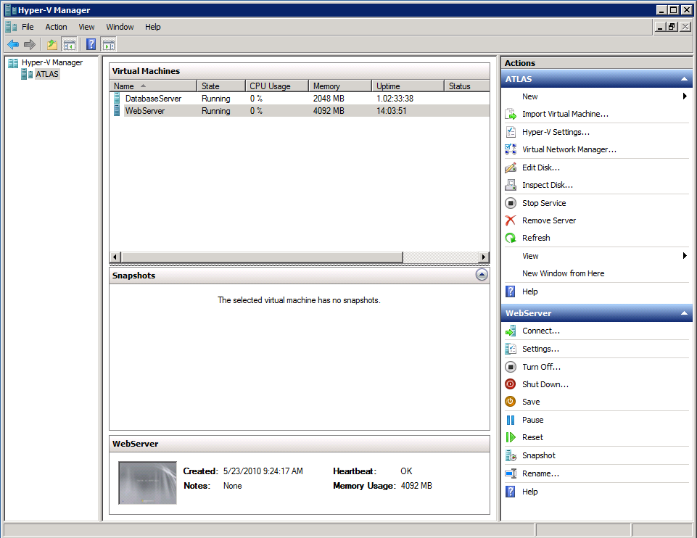
Getting Started with Hyper-V
Hyper-V is part of Windows Server 2008 (R2)
Host computer processor must support virtualization
Hyper-V Role must be enabled on host computer
Notes:
Hyper-V provides a scalable, reliable, and highly available virtualization platform. Some of the capabilities of Hyper-V include x64 host and guest support, ability to run guest machines in a multi-processor environment, large memory allocation per virtual machine, integrated virtual switch support, and ability to migrate virtual machines across hosts with minimal downtime.
You can enable the Hyper-V role on your server using the Server Manager. After the Hyper-V role is enabled, Hyper-V Manager will become available as a part of Administrative Tools. From the Hyper-V Manager users can easily create and configure virtual machines.
Try and run virtual machines of solid state drives

Slide 36
DEMO
Creating and Configuring VMs in Hyper-V

Slide 37
Summary
SharePoint Foundation Architecture
What's New in SharePoint 2010
SharePoint 2010 Product SKUs
Virtualization using Hyper-V

